Slide 1

The Relationship of Cell Temperature and Discharge Capacity Loss of LiFePO₄ Batteries
Design Exercise
Ming Gao
Oct 22, 2021

Slide 2
Problem Statement
Researchers at Stanford University completed a large batch of battery testing exploring the life time of A123 LiFePO₄ batteries.
They cycled many cells with varying fast charging protocols, but consistent discharges. During this cycling they measured current, voltage, capacity, power, and exterior cell temperature.
They concluded that they were able to predict the useful life (Capacity >80% beginning of life capacity) of the cell using information extracted from voltage curves early in life.
To do:
Explore the relationship of cell temperature/heat generated and cell discharge capacity loss
Determine whether it could be predictive

Slide 3
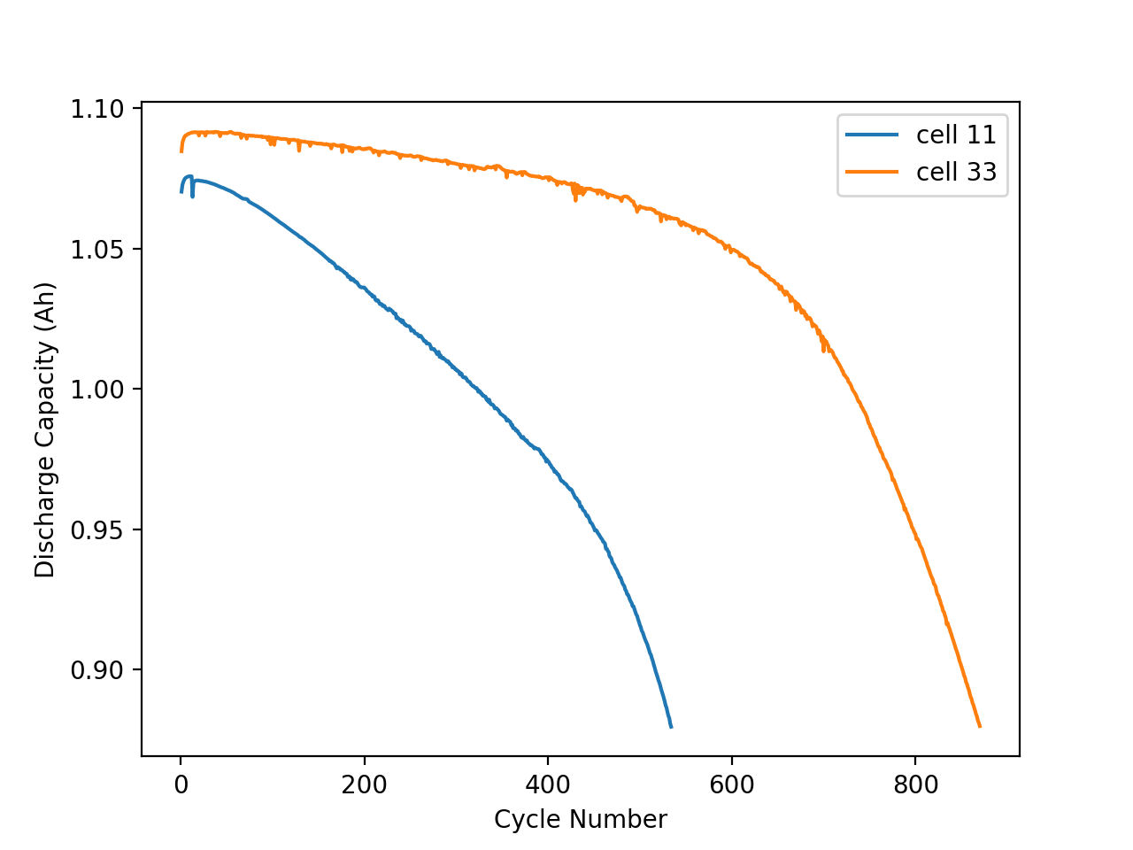
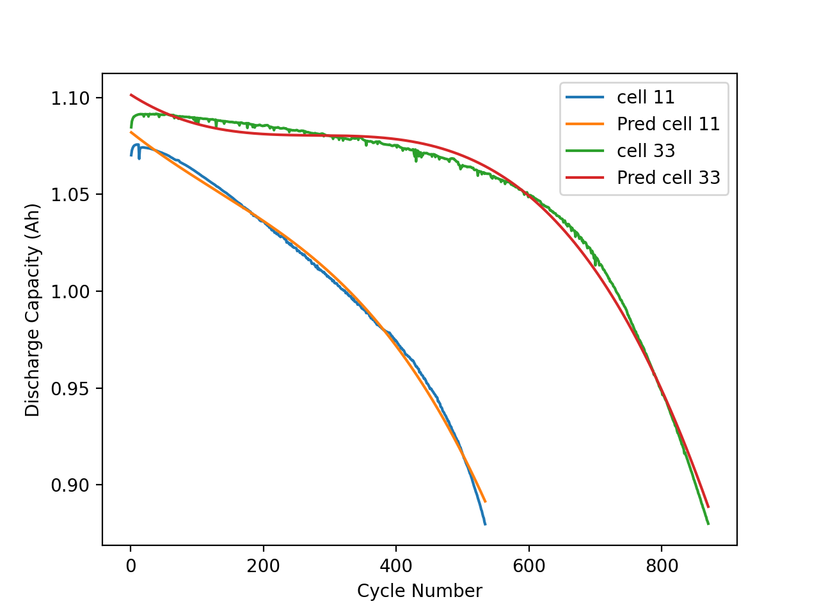
Battery Lifetime
Useful life (cell 11)= 583
Useful life (cell 33)= 869

Slide 4
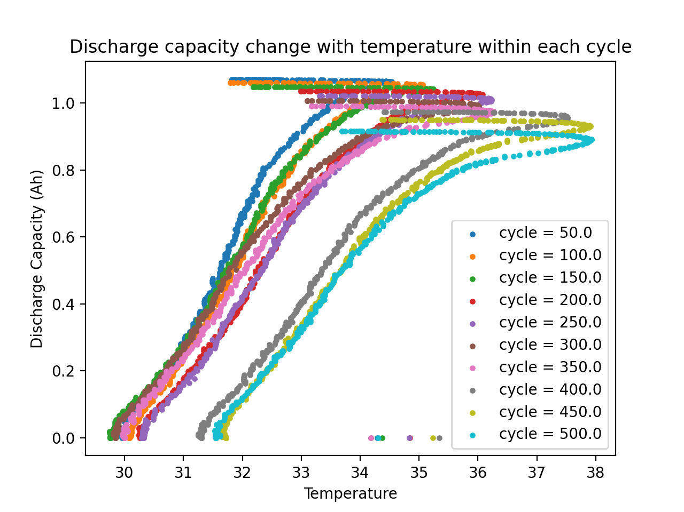
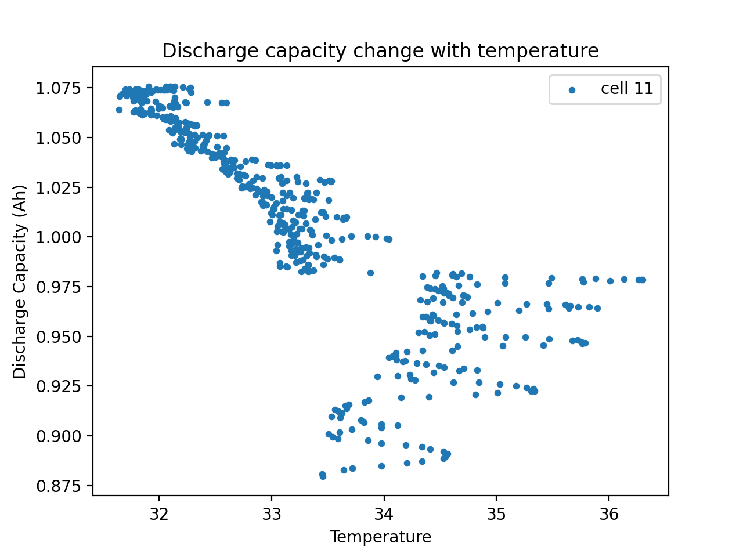
Discharge Capacity Loss vs. Temperature

Slide 5
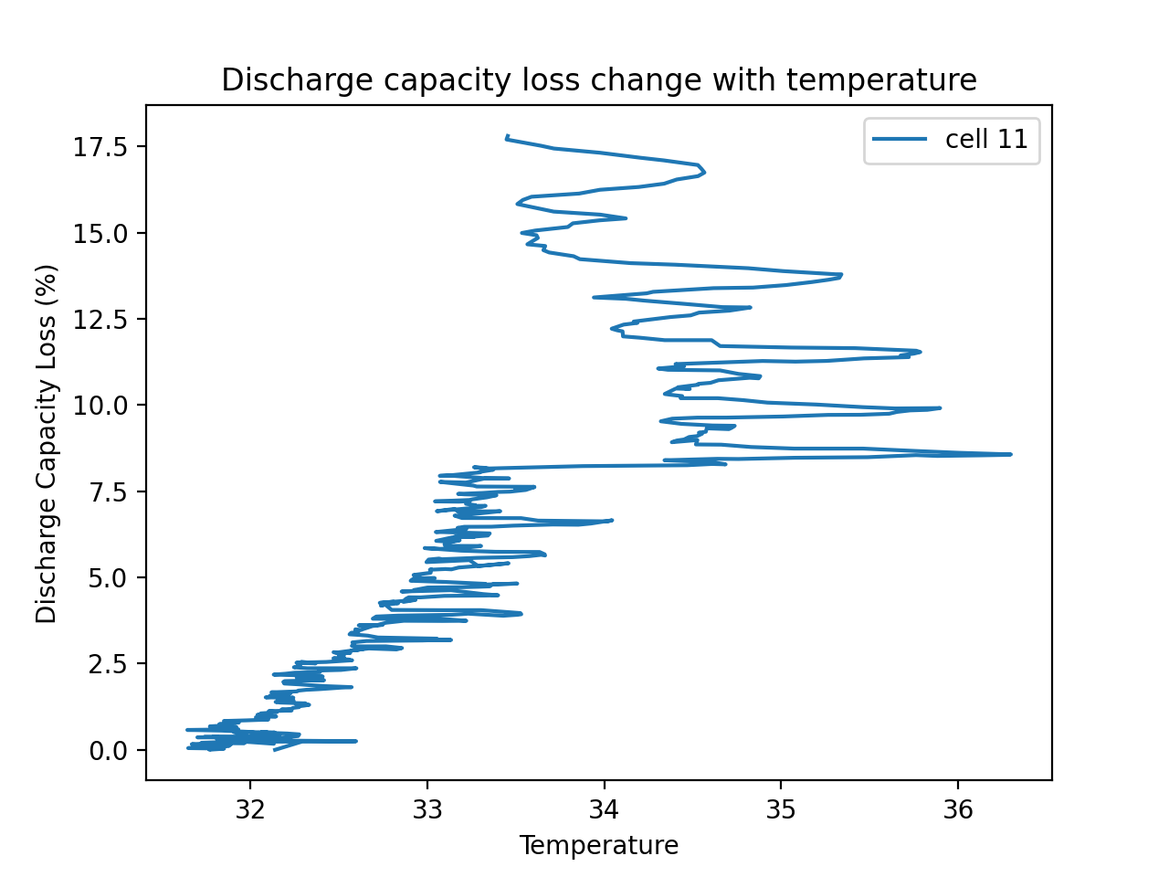
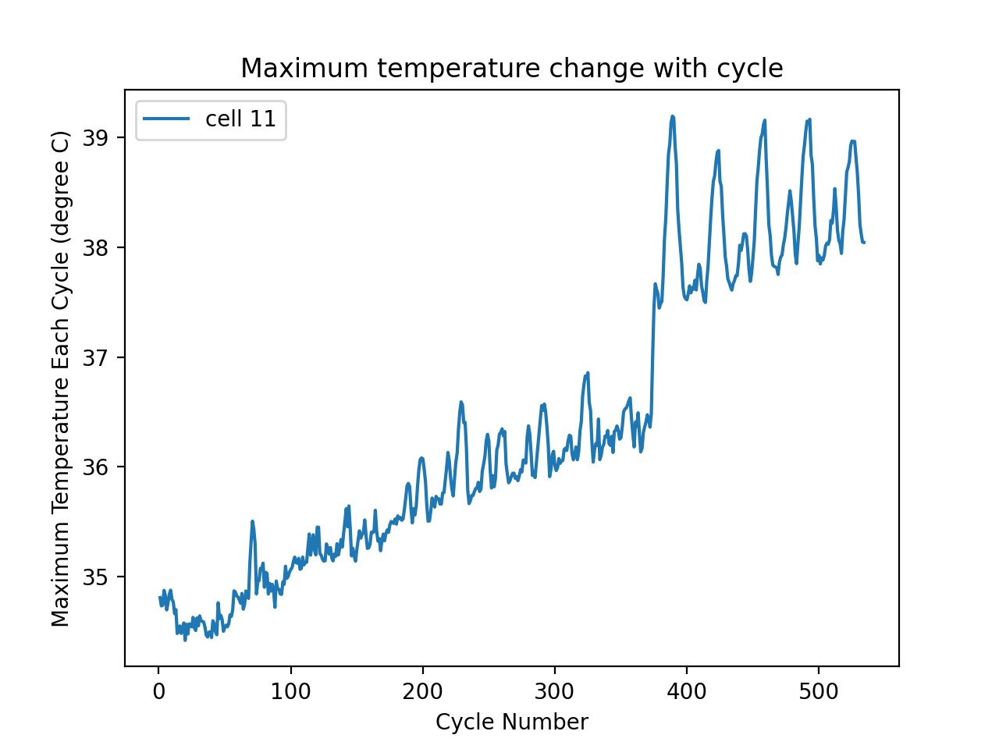
Discharge Capacity Loss vs. Temperature

Slide 6
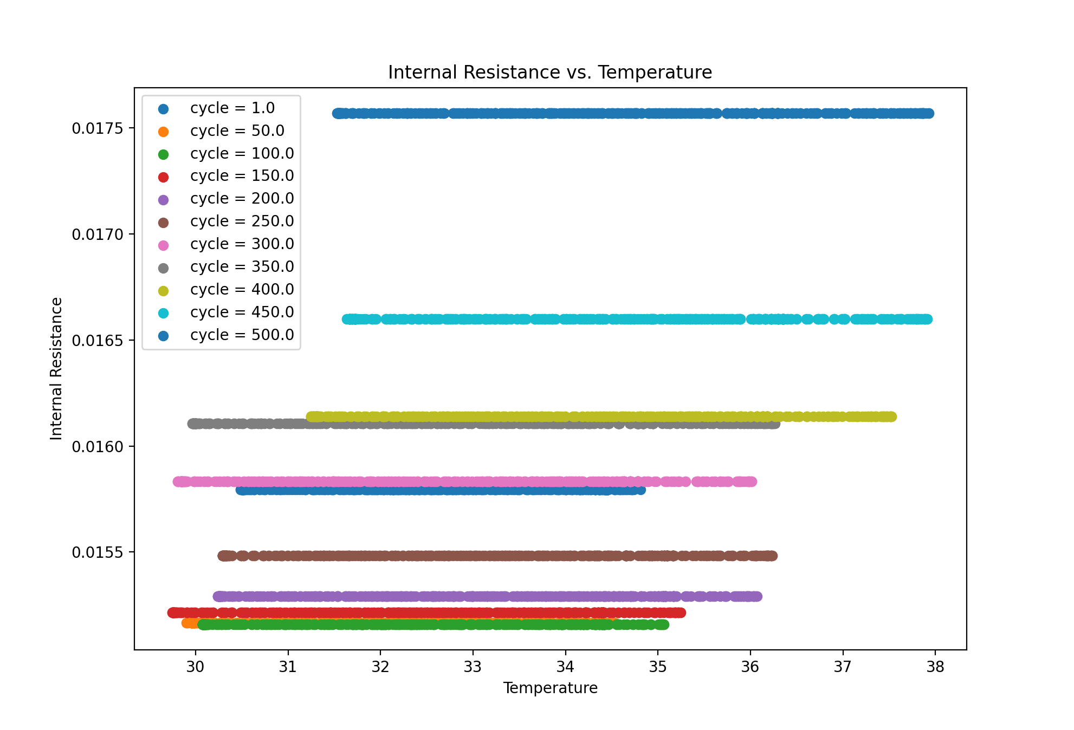
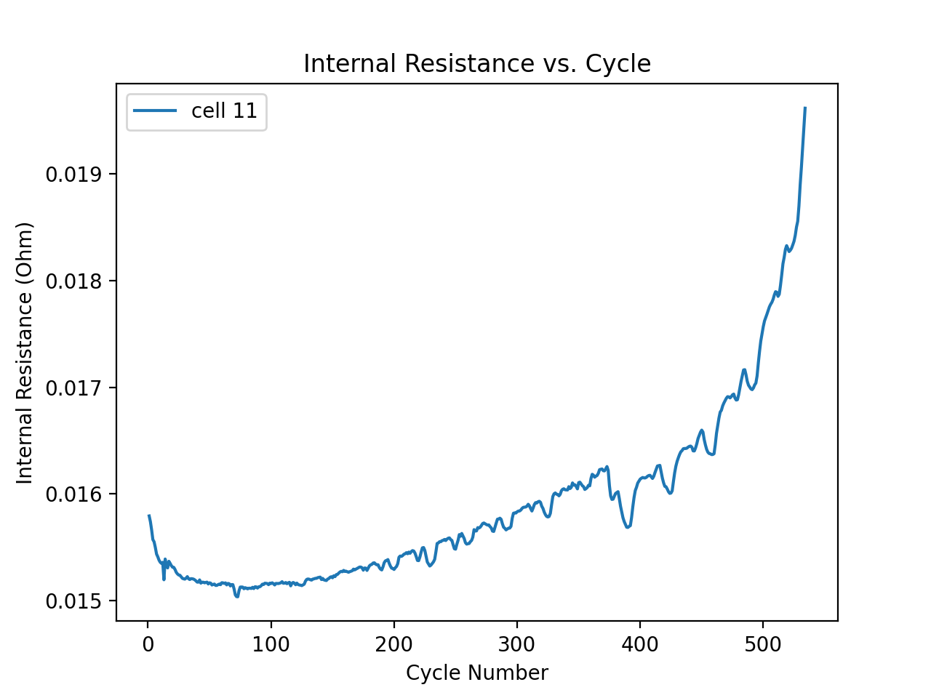
Internal Resistance (Impedance)

Slide 7
Conclusions
The internal resistance of the cell increases with charging-discharging cycles
The cell temperature elevates during the discharging process because of the heat generation of internal resistance
There is a tendency of maximum cell temperature increasing with cycles, need more data to extrapolate empirical relations

Slide 8
Things can be done next – Future work
Explore the effect of operating cell temperature with incubator temperature as variable
More data to extrapolate empirical relationship between max temperature and cycle
Build mechanistic model and equivalent circuit model to simulate the discharge capacity loss as a function of internal resistance and temperature

Slide 9
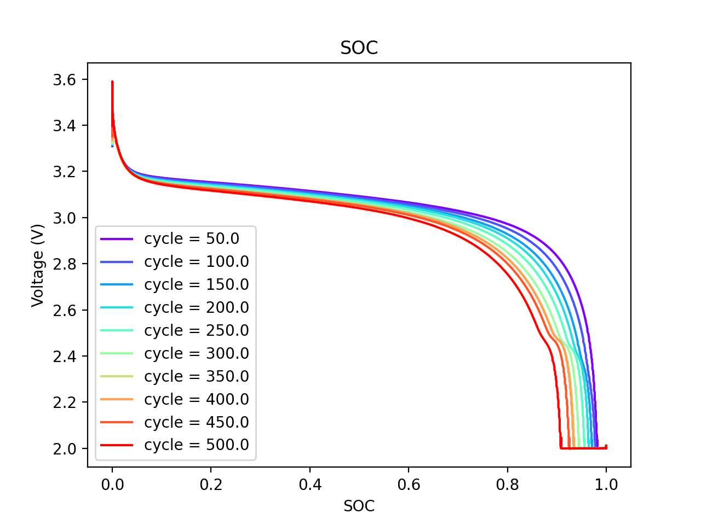
State of Charge

